Slide 1
Introduction to Statistics for Ecology and Evolutionary Biology Introduction to Multilevel Modeling Week 13 22 April 2019
Notes:
The goal for this lecture is to communicate the “what” and “how” of multilevel modeling
Broadly, multilevel strategies help our models learn more intelligently about the data at hand
Specifically when we have data organized into clusters of some sort: study sites, study individuals, etc.
“We should be justifying those times when we choose not use a multilevel model, not asking in every instance whether one would be useful.” – Richard McElreath, http://elevanth.org/blog/2017/08/24/multilevel-regression-as-default/

Slide 2
A Model of Many Names
Multilevel model will be the term most commonly used in this course
Hierarchical model is a (usually) synonymous term
As with multilevel model, the name hints at the fact that in these models, posterior inference has multiple targets
Mixed model is a (usually) synonymous term
When the outcome variable is something other than Gaussian, it is common to refer to a generalized linear mixed model (GLMM)
This name comes from the fact that these models are often said to contain main as well as varying (or random) effects
Notes:
The primary way to resolve these ambiguities is to define the model mathematically, which provides a more definitive description

Slide 3
Spiny-throated Reed Frog
Notes:
The experimental example in question concerns amphibian life history dynamics
For the modeling context, a primary issue is the fact that tanks are a crucial experimental unit
Tadpole density was manipulated at the tank-level and tank therefore represents a clustering variable
There is reason to believe even within experimental treatments that tanks may have some variation we wish to control for
Show lecture code introducing the reed frog data
https://www.iucnredlist.org/species/69119640/69119416

Slide 4
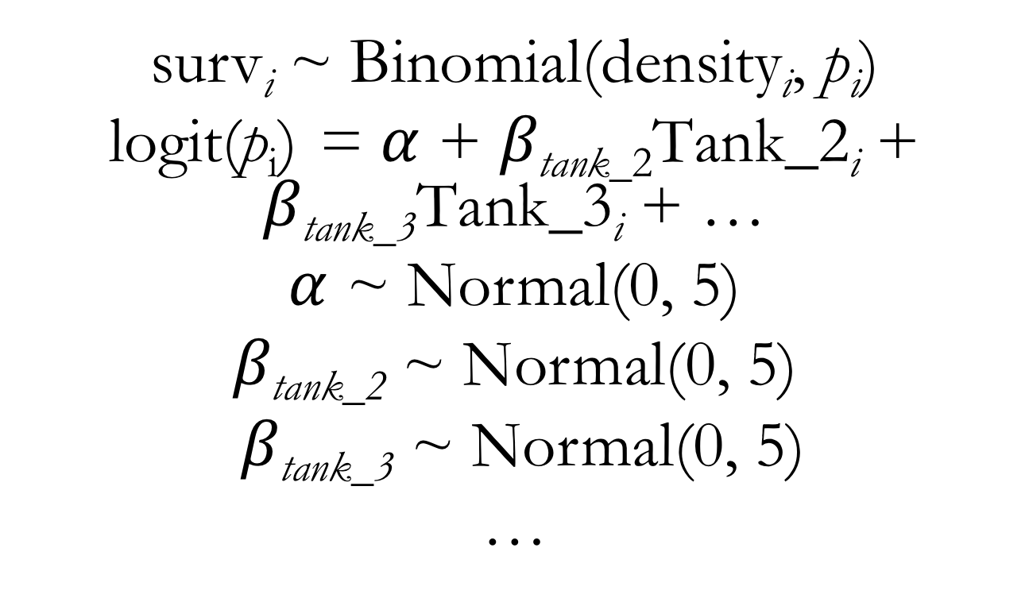
Binomial GLM for Reed Frog Survival Predictors: Tank (with the dummy variable approach)
surv_{i} ~ Binomial(density_{i}, $\text{p}\text{i}$)
logit(p_{i}) = $α$ + $β\text{tank}\text{_}\text{2}\text{Tank}\text{_2}\text{i}$ + $β\text{tank}\text{_3}\text{Tank}\text{_3}\text{i}$ + …
$α$ ~ Normal(0, 5)
$β\text{tank}\text{_2}$ ~ Normal(0, 5)
$β\text{tank}\text{_3}$ ~ Normal(0, 5)
…
Notes:
With the dummy variable coding approach, we fit an intercept term and every dummy variable’s coefficient represents one category’s difference (or offset) from the intercept value

Slide 5
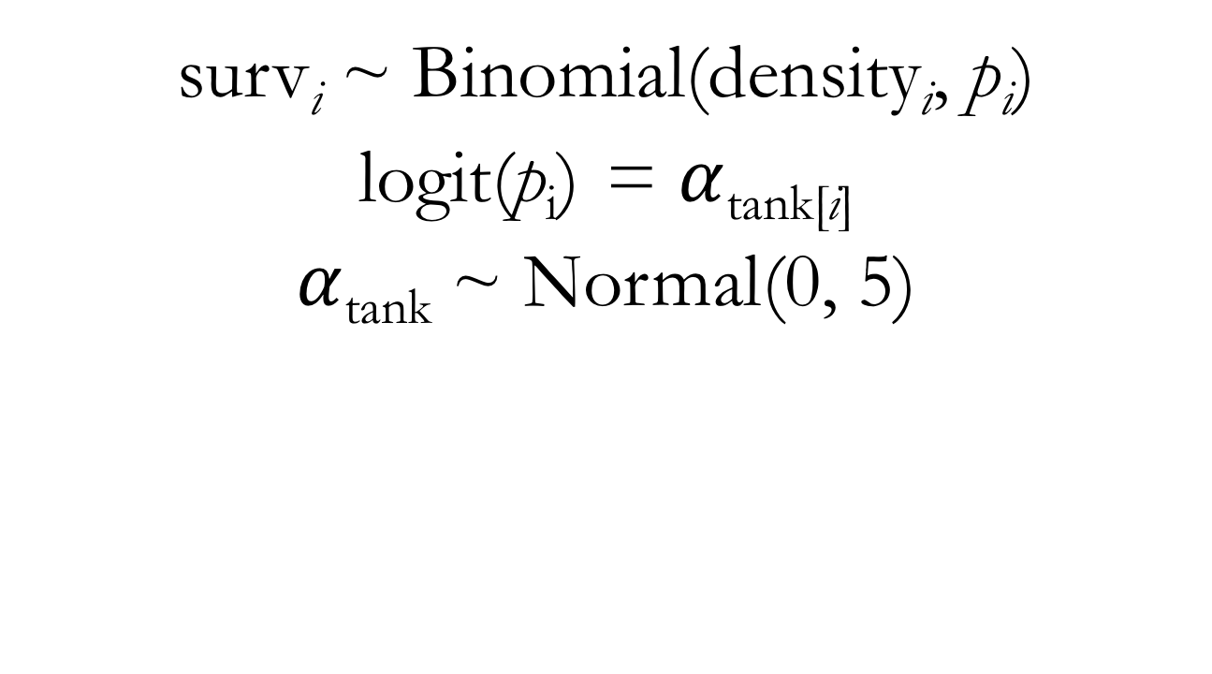
Binomial GLM for Reed Frog Survival Predictors: Tank (with an indexing approach)
surv_{i} ~ Binomial(density_{i}, $\text{p}\text{i}$)
logit(p_{i}) = $α$_{tank[i]}
$α$_{tank} ~ Normal(0, 5)
Notes:
With the indexing coding approach, we fit an intercept term that directly represents every category’s intercept value
Show lecture code for fitting a model using this strategy

Slide 6
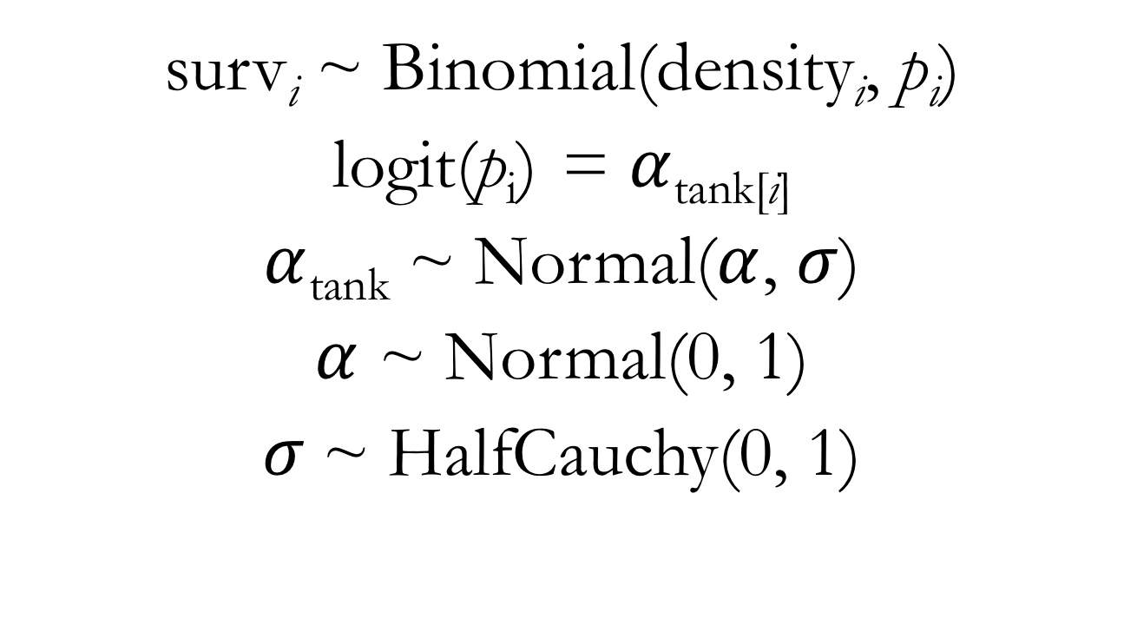
Binomial GLMM for Reed Frog Survival Predictors: Tank (with an indexing approach)
surv_{i} ~ Binomial(density_{i}, $\text{p}\text{i}$)
logit(p_{i}) = $α$_{tank[i]}
$α$_{tank} ~ Normal($α$, $σ$)
$α$ ~ Normal(0, 1)
$σ$~ HalfCauchy(0, 1)
Notes:
This is what’s known as a varying intercepts model: we’ll get a unique intercept for each cluster in the data

Slide 7
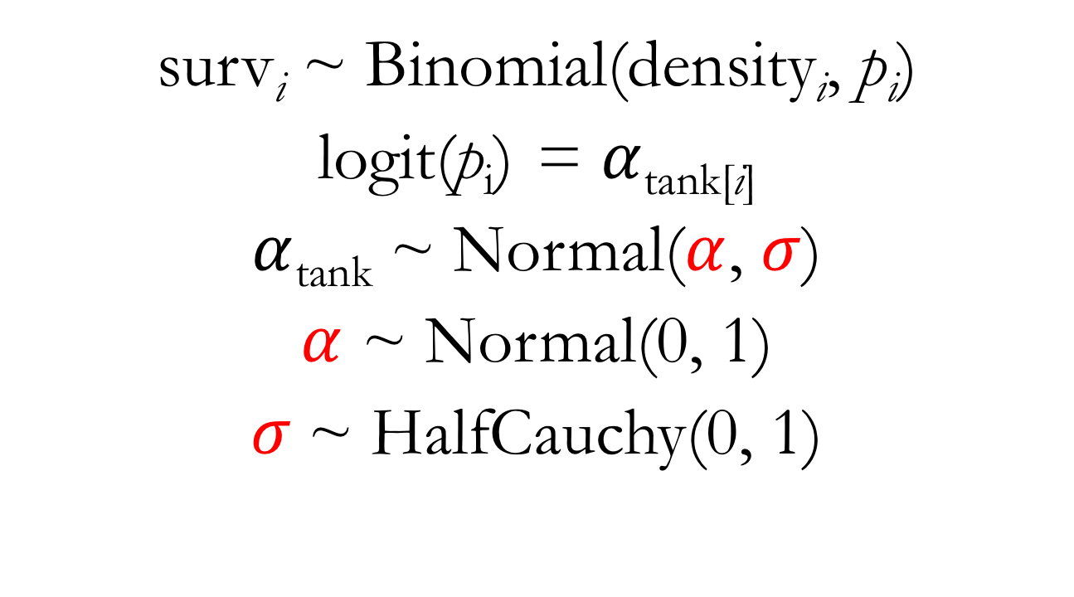
Binomial GLMM for Reed Frog Survival Predictors: Tank (with an indexing approach)
surv_{i} ~ Binomial(density_{i}, $\text{p}\text{i}$)
logit(p_{i}) = $α$_{tank[i]}
$α$_{tank} ~ Normal($α$, $σ$)
$α$ ~ Normal(0, 1)
$σ$~ HalfCauchy(0, 1)
Notes:
Alpha and sigma in this context are hyperparameters
They are parameters for parameters
Their priors are called hyperpriors
This structure is what allows our model to adaptively learn about variation among clusters
We estimate each tank’s intercept using information from the other tanks

